Slide 1
Supplyment Material

Slide 2
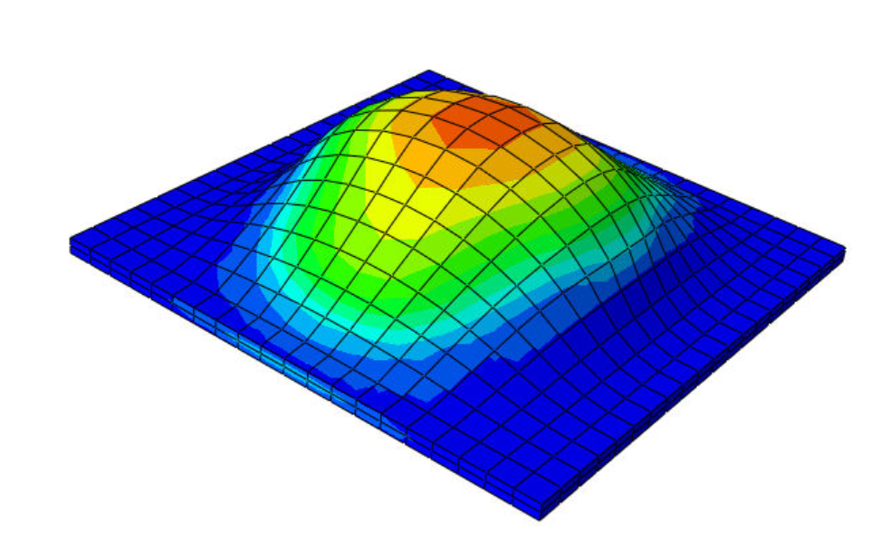
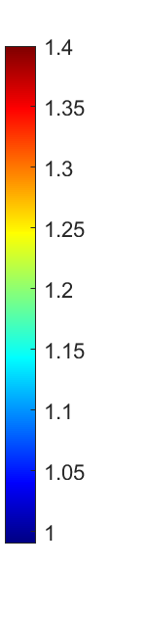
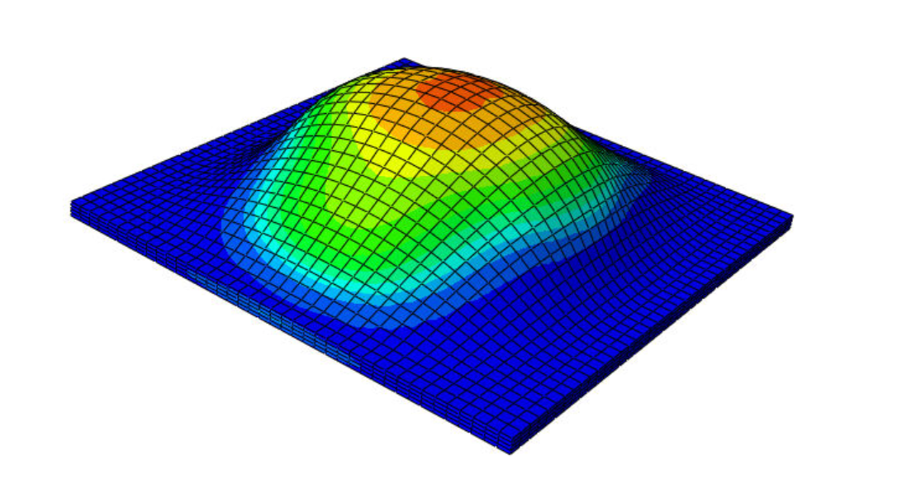

Mesh Convergence
At the center of the skin (50mm,50mm,3mm)
$θ^{g}$ with 50cc and only fix the sides
$$θ^{g}$$
t[days]
At day 7, there was 1.1% difference between two mesh

Slide 3
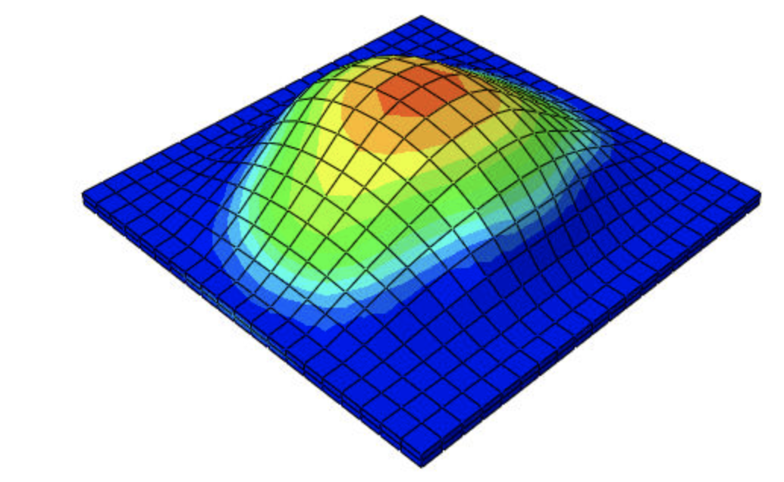
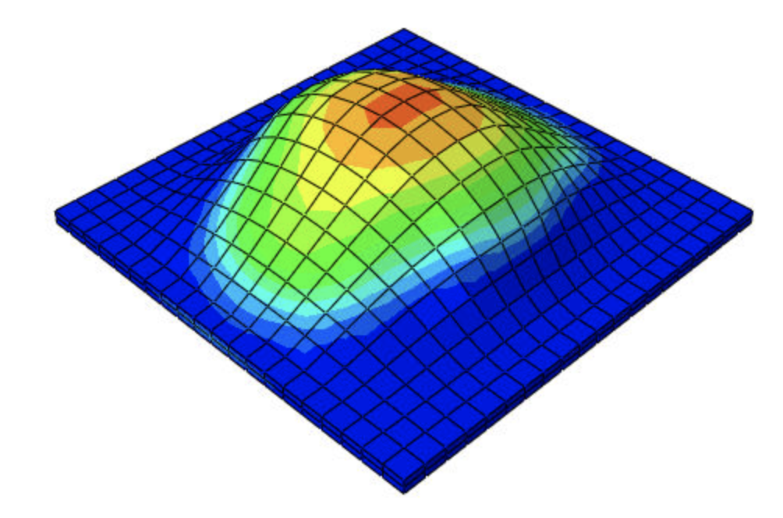

Add Friction
$θ^{g}$ with 50cc and only fix the sides
without friction
with friction (mu=0.1)

Slide 4
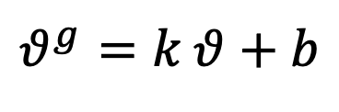
Linear Fit Th_g to Th
$$θ^{g}=k θ+b$$
k is under normal Distribution
b is under normal distribution
Likelihood is also normal.
Detailed parameters see next page

Slide 5
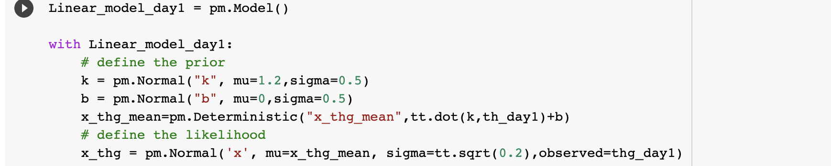
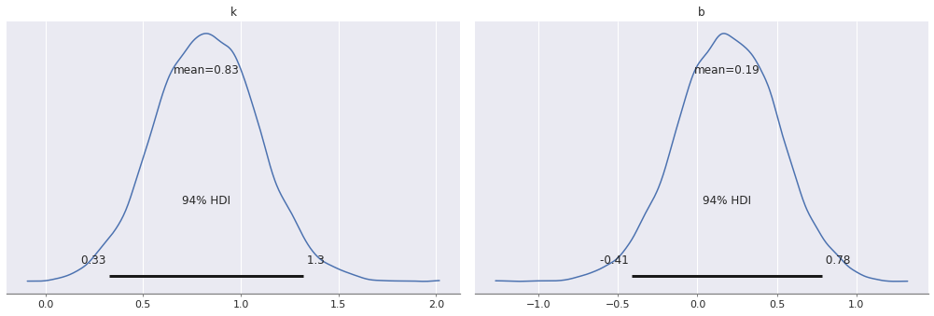
1 Day
Posterior

Slide 6
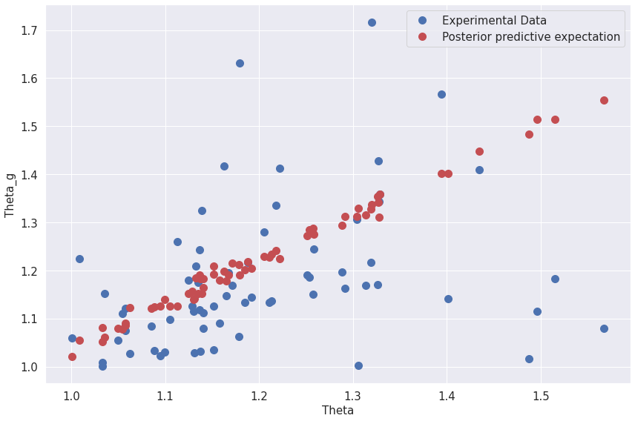
1 Day

Slide 7
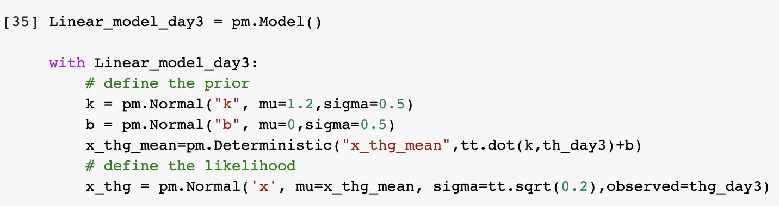
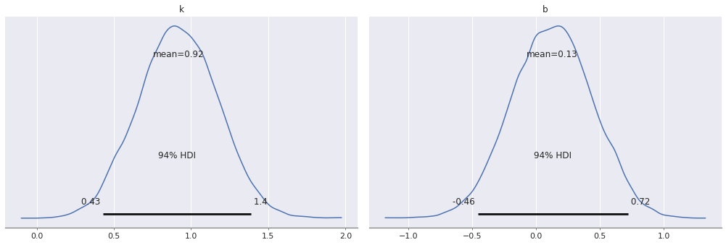
3 Day
Posterior

Slide 8
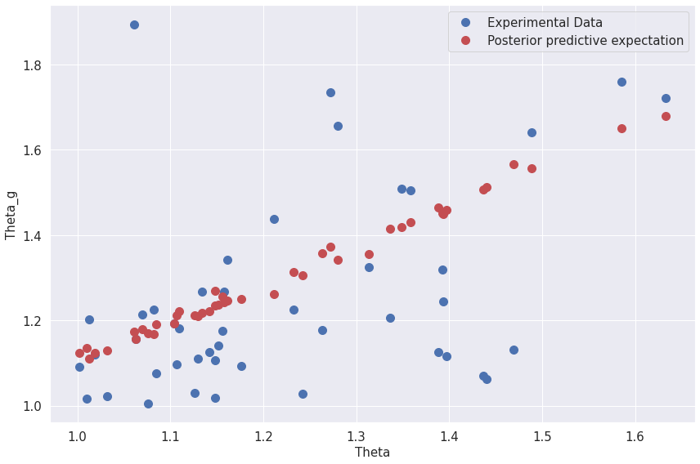
3 Day

Slide 9
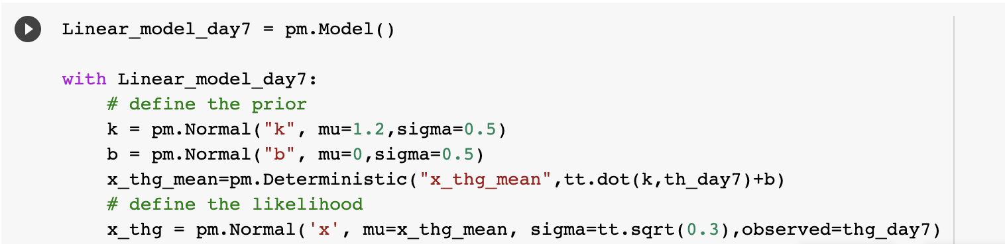
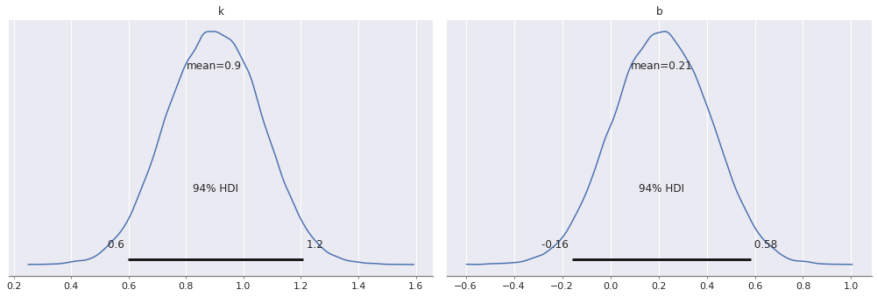
7 Day
Posterior

Slide 10
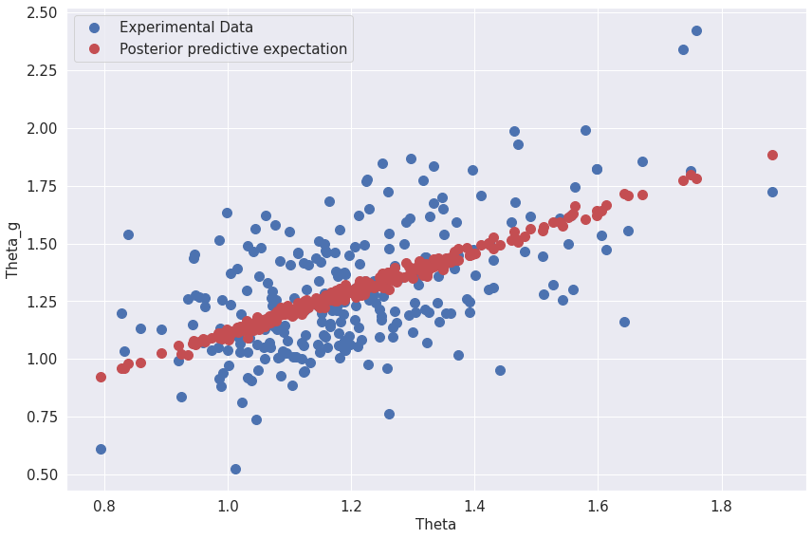
7 Day

Slide 11
Posterior Noise data: Iso

Slide 12
Posterior Noise data: G1

Slide 13
Posterior Noise data: G2

